Slide 1
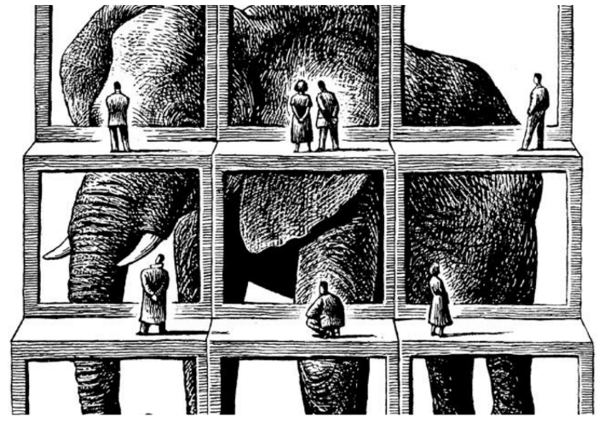
Context-Specific Embedding Spaces Recover Human Similarity
NCCL Lab Meeting – 23 July 2019
Tyler Giallanza, Marius Cătălin Iordan, Cameron T. Ellis, Nicole Beckage, Jonathan D. Cohen

Slide 2
Similarity is a Fundamental Cognitive Primitive
Simplify this – don’t step through the examples
We create a method to recover human similarity judgments in a data-driven way, which helps both human cognition research and NLP tasks.
Tversky (1977), Nosofsky (1985), Ashby & Lee (1991), Osherson (1991), and more

Slide 3
Similarity is a Fundamental Cognitive Primitive
Categorization
Tversky (1977), Nosofsky (1985), Ashby & Lee (1991), Osherson (1991), and more

Slide 4
Similarity is a Fundamental Cognitive Primitive
Categorization
Identification
Tversky (1977), Nosofsky (1985), Ashby & Lee (1991), Osherson (1991), and more

Slide 5
Similarity is a Fundamental Cognitive Primitive
Categorization
Identification
Generalization
Tversky (1977), Nosofsky (1985), Ashby & Lee (1991), Osherson (1991), and more

Slide 6
Similarity is a Fundamental Cognitive Primitive
Categorization
Identification
Generalization
Learning
Tversky (1977), Nosofsky (1985), Ashby & Lee (1991), Osherson (1991), and more

Slide 7
Similarity is Consistent but Difficult to Estimate
Show the 3 already – only show one image for each not all 3 imgs
Also ppl consistent across time

Slide 8
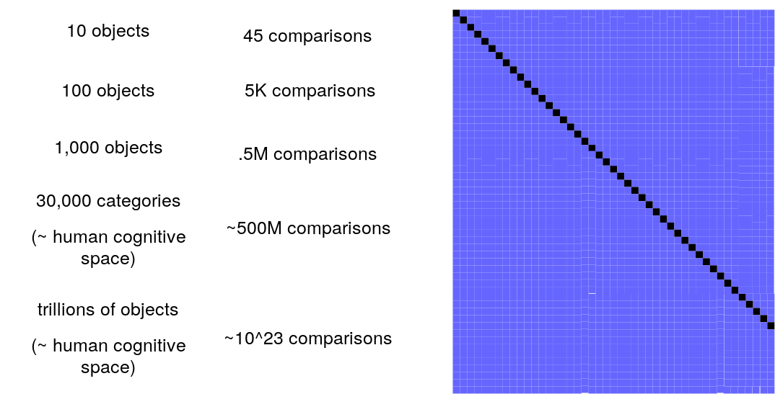
Collecting Data is Difficult

Slide 9
Collecting Data is Difficult

Slide 10
Collecting Data is Difficult

Slide 11
Collecting Data is Difficult

Slide 12
Collecting Data is Difficult

Slide 13
Similarity in NLP
No sparse – they want similar distances b/w similar concepts (semantically similar) – this is key for generalization

Slide 14
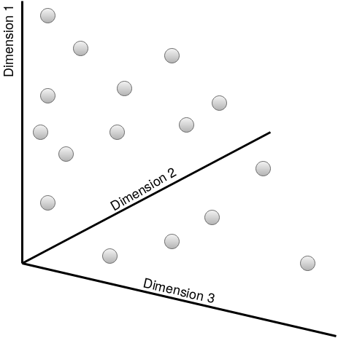
Similarity in NLP
How are these built – co-occurance (syntactic context which is an approximation for semantic context) from large text datasets (“all of human knowledge”)
Abstract space – uninterp dimensions but you can extract relationships (categorical prediction, cultural stereotypes, etc – you can get useful info from these spaces)

Slide 15
Similarity in NLP
Nearest Neighbors
General:
50-75% of Human Variance
NLP uses a shitty proxy – they can’t capture human similarity (haven’t even tested it b/c data is expensive)
Pennington et al. (2014)

Slide 16
Similarity in NLP
Nearest Neighbors
General:
50-75% of Human Variance
Fine-Grained:
<10% of Human Variance
Pennington et al. (2014)

Slide 17
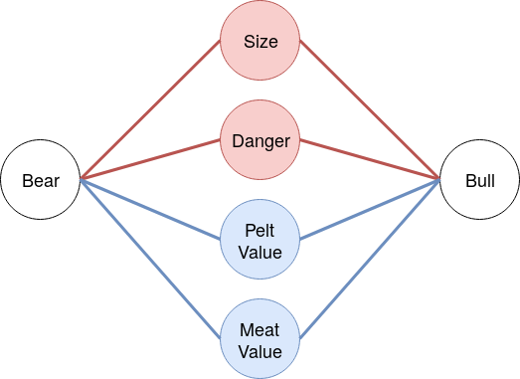
New Title
semantic context
semantic context

Slide 18
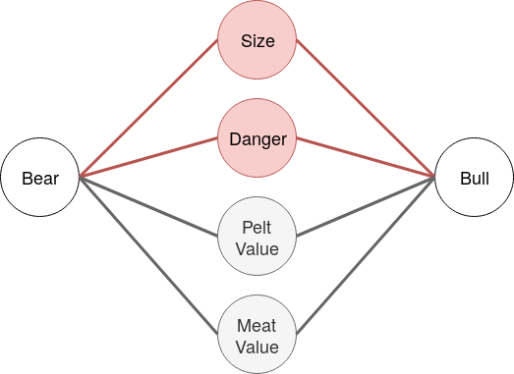
New Title

Slide 19
Hypothesis
Context Improves Embedding Spaces

Slide 20
Hypothesis
Context Improves Embedding Spaces
2 New Methods for Adding Context
Make this a better roadmap and put it in the presentation multiple times on section switch
Add a slide with the stims for each context

Slide 21
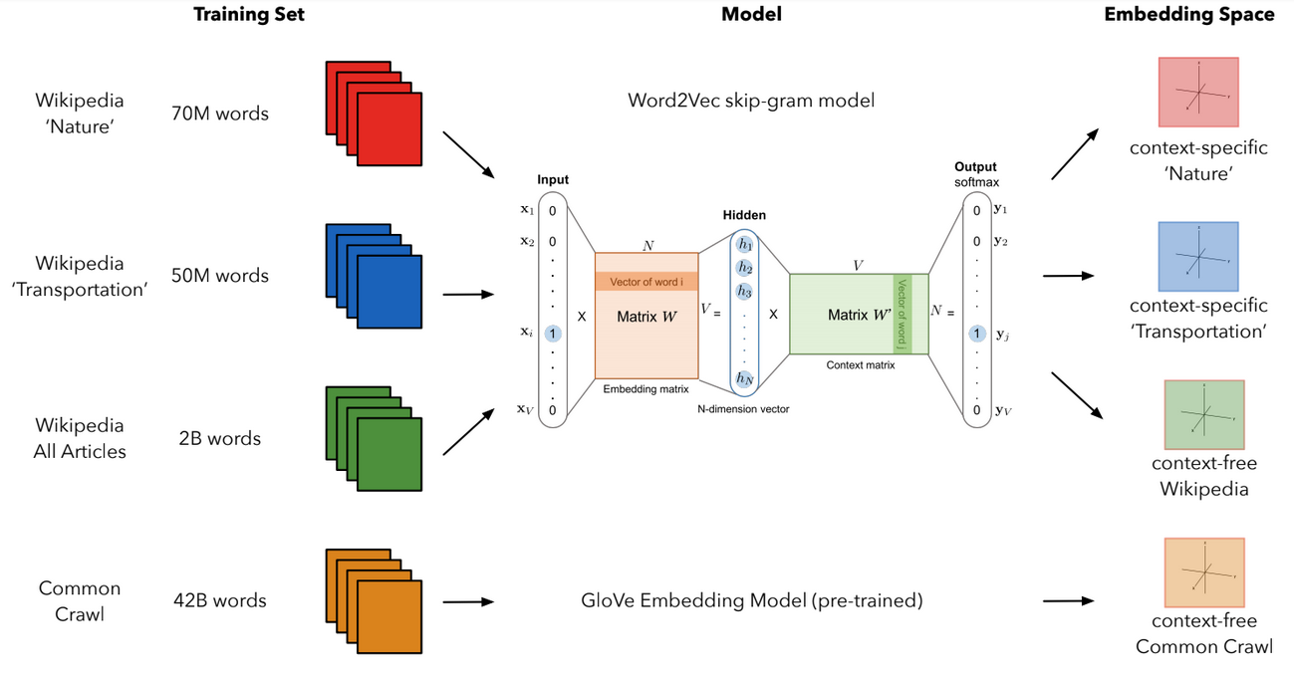
Method 1: Context-Specific Corpora

Slide 22
Method 1: Context-Specific Corpora

Slide 23
Method 1: Context-Specific Corpora

Slide 24
Method 1: Context-Specific Corpora

Slide 25
Method 1: Context-Specific Corpora

Slide 26
Compare to Human Judgments

Slide 27
Compare to Human Judgments
Mechanical Turk N=105

Slide 28
Compare to Human Judgments
Mechanical Turk N=105
45 pairwise combinations/context

Slide 29
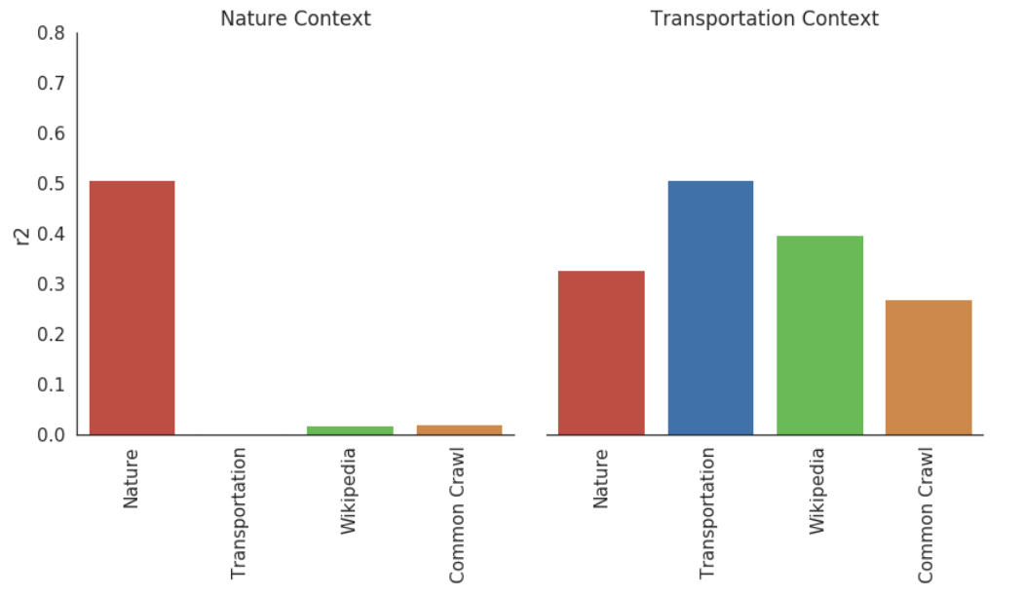
Results: Beats Traditional Models

Slide 30
Results: Beats Traditional Models
Fewer words but BETTER words – choose the right words
Quality > quanitity

Slide 31
Other Comparison: SPoSE
Zheng et al. (2019)

Slide 32
Other Comparison: SPoSE
1,854 images
Zheng et al. (2019)

Slide 33
Other Comparison: SPoSE
1,854 images
1.5 million human judgments
Zheng et al. (2019)

Slide 34
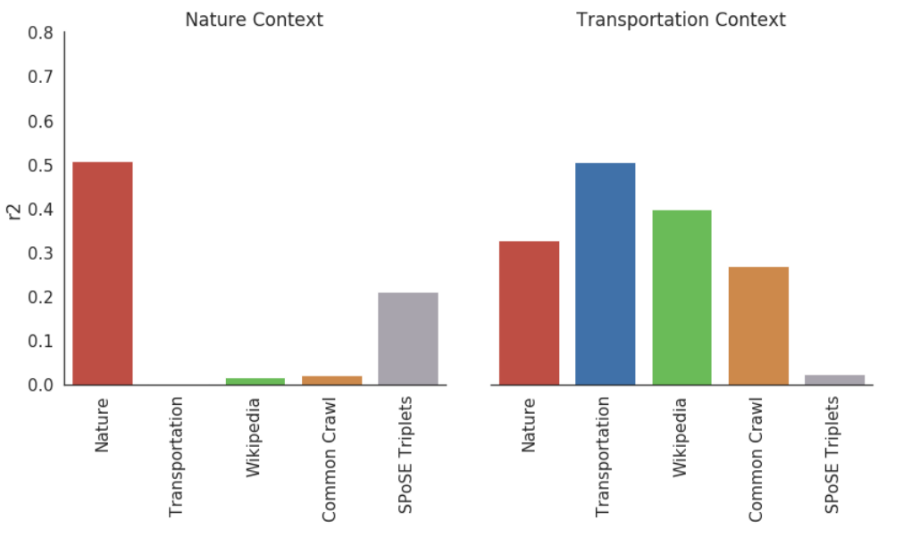
New Title

Slide 35
Redo roadmap

Slide 36
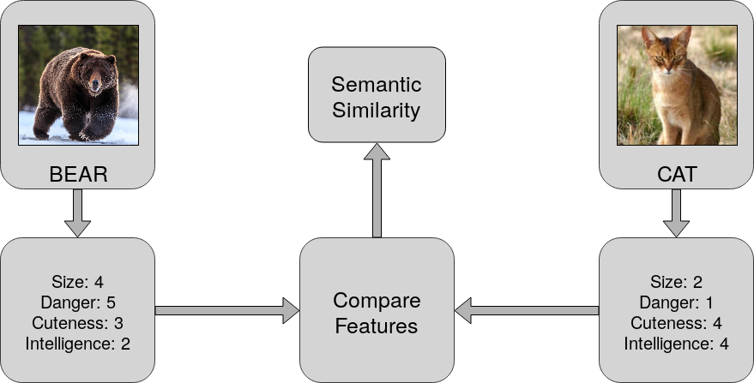
Method 2: Feature Information
Tversky (1977), Nosofsky (1985), Ashby & Lee (1991), Osherson (1991), and more

Slide 37
Method 2: Feature Information
Tversky (1977), Nosofsky (1985), Ashby & Lee (1991), Osherson (1991), and more

Slide 38
Method 2: Feature Information
Tversky (1977), Nosofsky (1985), Ashby & Lee (1991), Osherson (1991), and more

Slide 39
Method 2: Feature Information
Tversky (1977), Nosofsky (1985), Ashby & Lee (1991), Osherson (1991), and more

Slide 40
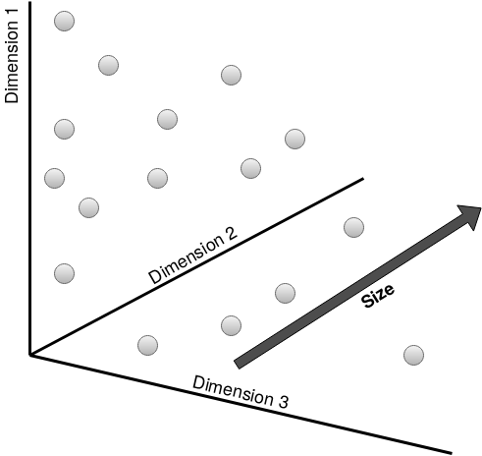
Adjective Projection
Define Feature Dimension
Talk about this less
Grand et al. (2018)

Slide 41
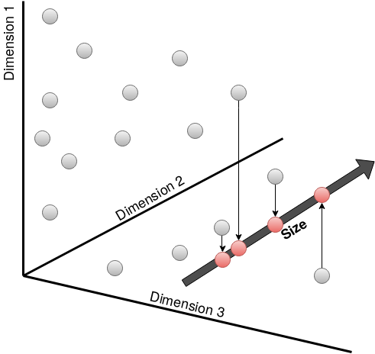
Adjective Projection
Define Feature Dimension
Project onto Feature Dimension
Grand et al. (2018)

Slide 42
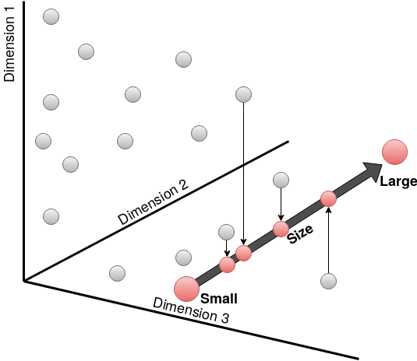
Adjective Projection
Define Feature Dimension
Project onto Feature Dimension
Add atom/universe example
Use Adjective Feature Endpoints
Grand et al. (2018)

Slide 43
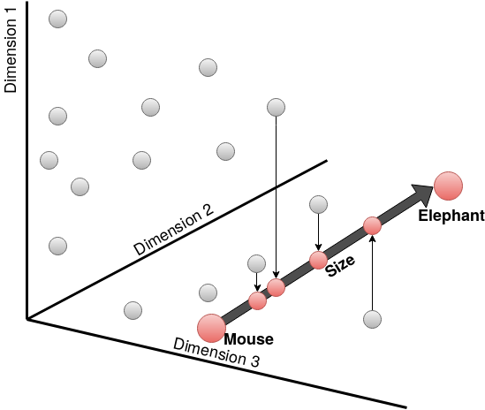
Contextual Projection
Define Feature Dimension
Project onto Feature Dimension
Use Context Feature Endpoints

Slide 44
Human Feature Ratings

Slide 45
Human Feature Ratings
Mechanical Turk N=18-32

Slide 46
Human Feature Ratings
Mechanical Turk N=18-32
12 features/context

Slide 47
Results: Recovers Feature Information

Slide 48
Results: Recovers Feature Information
Use the full table – color is when our model wins (which is for most of the dimensions, 10/12 for each context) – shows the same double dissoc of on-context model doing the best
One table per slide – have it colored from the beginning
This is important by itself – feature ratings are really cool and nobody could get them before we did it

Slide 49
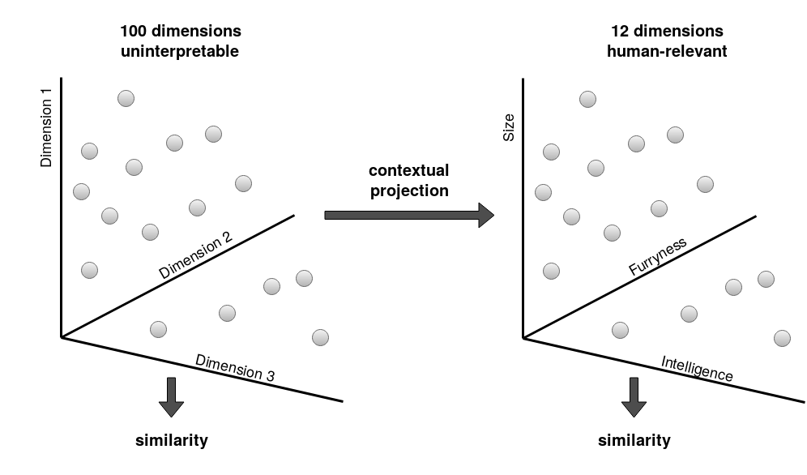
Features → Object Similarity

Slide 50
Features → Object Similarity

Slide 51
Features → Object Similarity

Slide 52
Features → Object Similarity

Slide 53
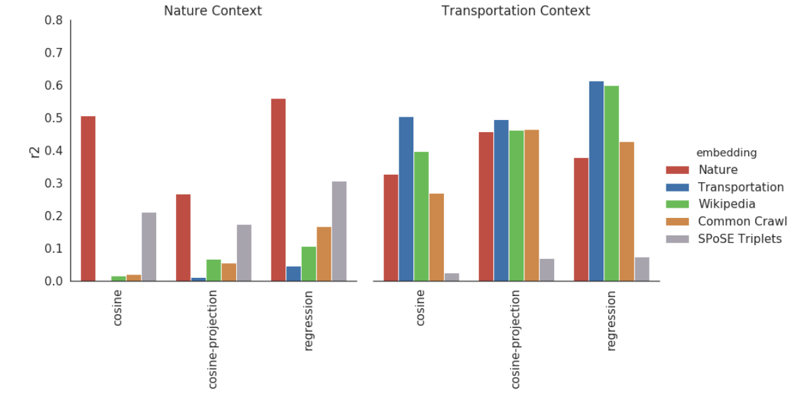
Results: Features → Object Similarity

Slide 54
Results: Features → Object Similarity

Slide 55
Results: Features → Object Similarity
Start with just organge and green

Slide 56
New Title

Slide 57
New Title

Slide 58
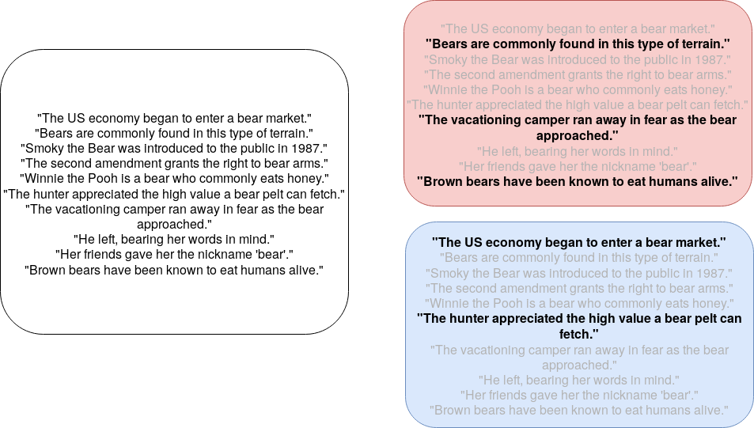
Why it Works: Context is like Attention

Slide 59
Why it Works: Context is like Attention

Slide 60
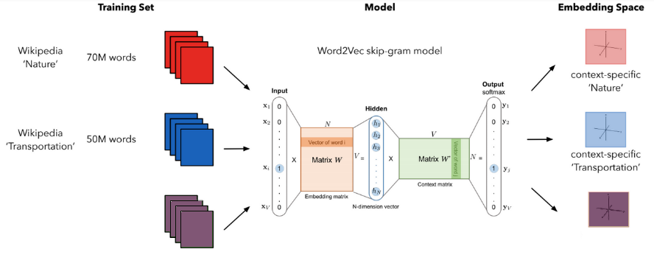
Mixing Contexts

Slide 61
Mixing Contexts
Combined 60M words
Combined

Slide 62
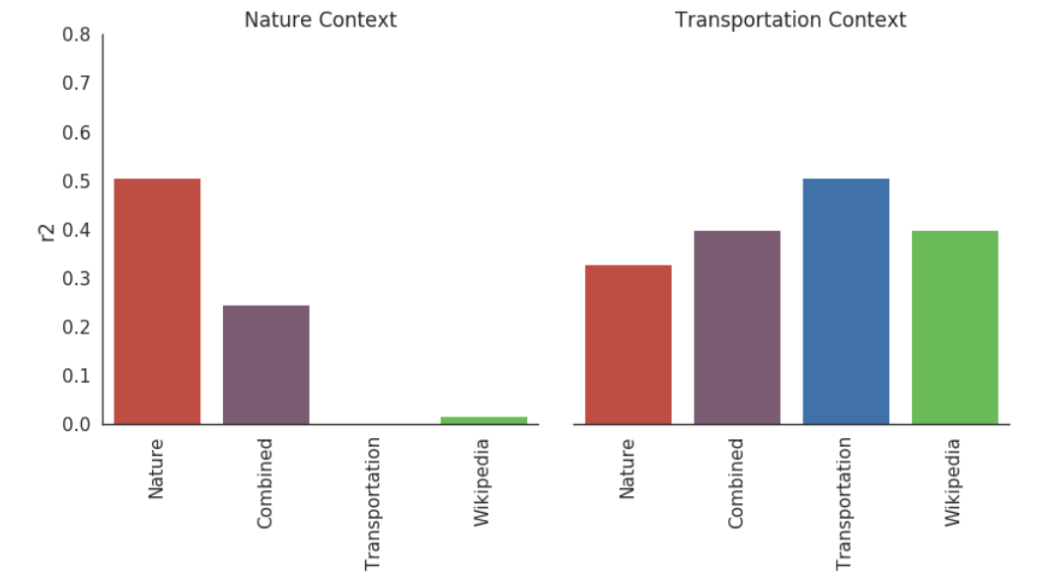
Results: Mixing Contexts
Mixing both makes it more difficult to get human info from either

Slide 63
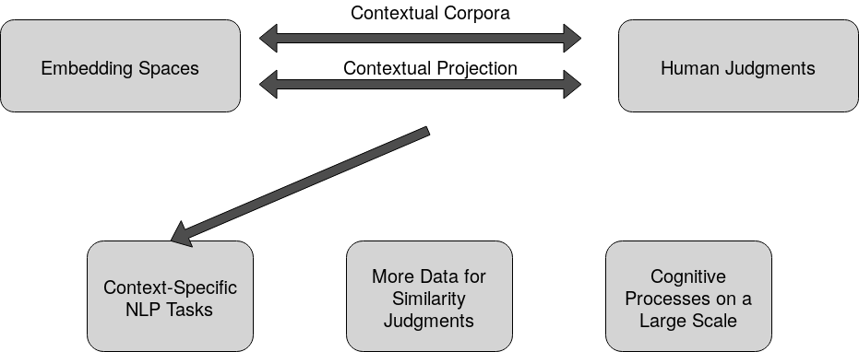
Conclusion

Slide 64
Conclusion

Slide 65
Conclusion

Slide 66
Conclusion

Slide 67
Conclusion

Slide 68
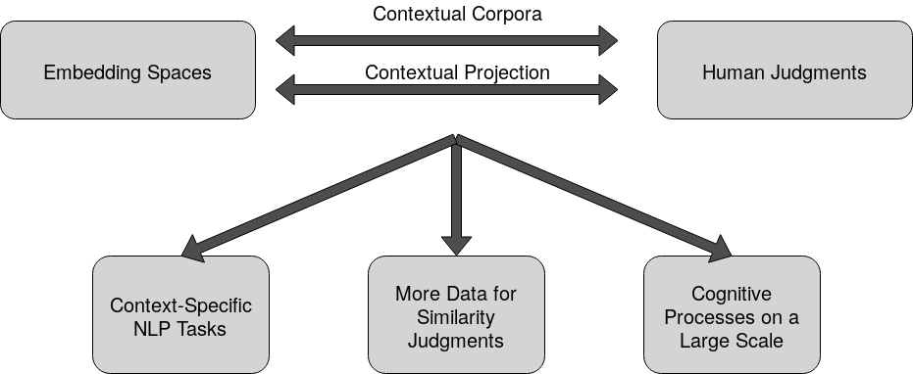
Conclusion
Switch order of conclusions 1 and 2
Conclusion 3: run experiments at a larger scale – strength of the reality of human data and large-scalededness of NLP (the whole point of semantic similarity is that we can use it for other cooler tasks)

